Slide 1
View Data by Figure
Wenbo ZHANG
School of Science, BUPT
zhangwb_wk@163.com

Slide 2
Overview of Plotting
Interactive Plotting
Editing Plots
Saving Your Work
Basic Plotting Commands
Printing and Exporting

Slide 3
OVERVIEW OF plotting

Slide 4
What Is a MATLAB® Graph?
Anatomy of a Graph
Figure Toolbars
Types of MATLAB® Plots

Slide 5
What Is a MATLAB® Graph?
The MATLAB® environment offers you a variety of data plotting functions plus a set of GUI tools to create, and modify graphic displays. The GUI tools afford most of the control over graphic properties and options that typed commands such as annotate, get, and set provide.
A figure is a MATLAB window that contains graphic displays (usually data plots) and UI components. You create figures explicitly with the figure function, and implicitly whenever you plot graphics and no figure is active. By default, figure windows are resizable and include pull-down menus and toolbars.

Slide 6
What Is a MATLAB® Graph?
A plot is any graphic display you can create within a figure window. Plots can display tabular data, geometric objects, surface and image objects, and annotations such as titles, legends, and colorbars. Figures can contain any number of plots. Each plot is created within a 2-D or a 3-D data space called an axes. You can explicitly create axes with the axes or subplot functions.
A graph is a plot of data within a 2-D or 3-D axes. Most plots made with MATLAB functions and GUIs are therefore graphs.

Slide 7
Anatomy of a Graph
MATLAB plotting functions and tools direct their output to a figure window. Each figure is a separate window that you can dock in the desktop, and collect together with other plots in a Figure Group.
x = [0:.2:20];
y = sin(x)./sqrt(x+1);
y(2,:) = sin(x/2)./sqrt(x+1);
y(3,:) = sin(x/3)./sqrt(x+1);
plot(x,y)
The resulting figure contains a 2-D set of axes.

Slide 8
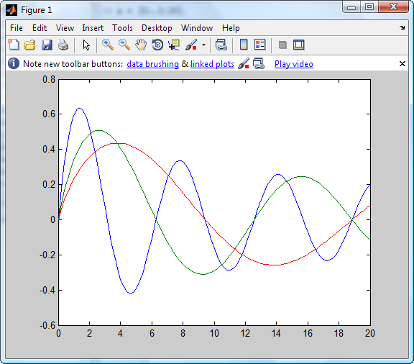
Anatomy of a Graph
One of the figure
toolbars
Dock figure in desktop
MATLAB figure
window
Axes
Line plots representing data

Slide 9
Anatomy of a Graph
The plot function uses a default line style and color to distinguish the data sets plotted in the graph. You can change the appearance of these graphic components or add annotations to the graph to present your data in a particular way.

Slide 10
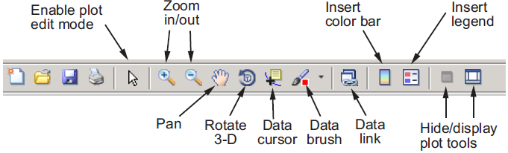
Figure Toolbars
Figure toolbars provide shortcuts to access commonly used features. These include operations such as saving and printing, plus tools for interactive zooming, panning, rotating, querying, and editing plots. The following picture shows the features available from this toolbar.

Slide 11
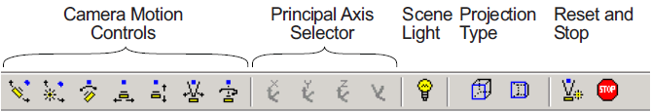
Figure Toolbars
You can enable two other toolbars from the View menu.
Camera Toolbar
Camera Motion Controls — These tools select which camera motion function to enable. You can also access the camera motion controls from the Tools menu.

Slide 12
Figure Toolbars
Camera Toolbar
Principal Axis Selector — Some camera controls operate with respect to a particular axis. These selectors enable you to select the principal axis or to select nonaxis constrained motion. The selectors are grayed out when not applicable to the currently selected function. You can also access the principal axis selector from the Tools menu.

Slide 13
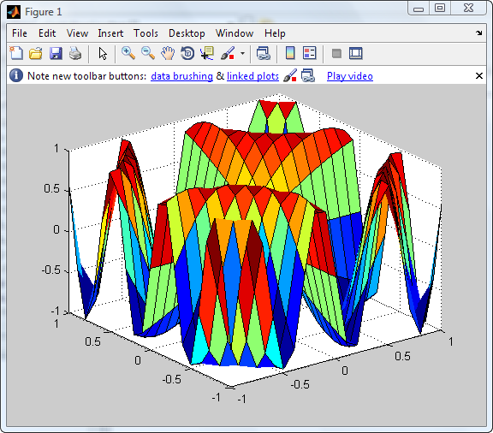
Principal Axes
The principal axis of a scene defines the direction that is oriented upward on the screen. For example, a MATLAB® surface plot aligns the up direction along the positive z-axis.

Slide 14
Orbit Camera
Orbit Camera rotates the camera about the z-axis (by default). You can select x-, y-, z-, or free-axis rotation using the Principal Axis Selectors. When using no principal axis, you can rotate about an arbitrary axis.

Slide 15
Orbit Scene Light
The scene light is a light source that is placed with respect to the camera position. By default, the scene light is positioned to the right of the camera (i.e., camlight right). Orbit Scene Light changes the light’s offset from the camera position. There is only one scene light; however, you can add other lights using the light command.

Slide 16
Figure Toolbars
Camera Toolbar
Scene Light — The scene light button toggles a light source on or off in the scene (one light per axes).
Projection Type — You can select orthographic or perspective projection types.

Slide 17
Figure Toolbars
Camera Toolbar
Reset and Stop — Reset returns the scene to the standard 3-D view. Stop causes the camera to stop moving (this can be useful if you apply too much cursor movement). You can also access an expanded set of reset functions from the Tools menu.

Slide 18
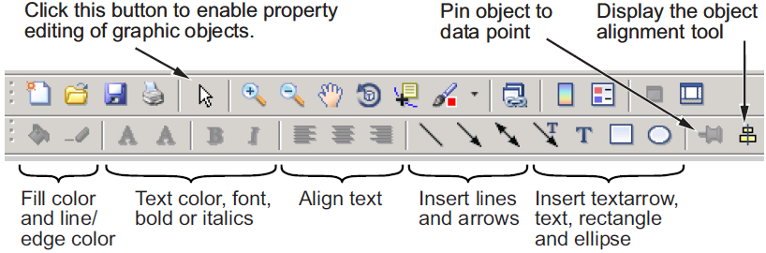
Figure Toolbars
Plot Edit Toolbar
Use for annotation and setting object properties.
Notes:
Example of Dolling Cammra.

Slide 19
Types of MATLAB® Plots
You can construct a wide variety of 2-D and 3-D MATLAB plots with very little, if any, programming required on your part.
They include line, bar, area, direction and vector field, radial, and scatter graphs.
They also include 2-D and 3-D functions that generate and plot geometric shapes and objects.
Most 2-D plots have 3-D analogs, and there are a variety of volumetric displays for 3-D solids and vector fields.

Slide 20







Two-Dimensional Plotting Functions
Line Graphs
plot
plotyy
loglog
semilogx
semilogy
stairs
contour
ezplot
ezcontour

Slide 21








Two-Dimensional Plotting Functions
Bar Graphs
bar(grouped)
barh(grouped)
bar(stacked)
barh(stacked)
hist
pareto
errorbar
stem

Slide 22






Two-Dimensional Plotting Functions
Area Graphs
area
pie
fill
contourf
image
pcolor
ezcontourf

Slide 23






Two-Dimensional Plotting Functions
Direction Graphs
feather
quiver
comet
Radial Graphs
polar
rose
compass
ezpolar

Slide 24



Two-Dimensional Plotting Functions
Scatter Graphs
scatter
scatter
plotmatrix

Slide 25




Three-Dimensional Plotting Functions
Line Graphs
plot3
contour3
contourslice
ezplot3
waterfall

Slide 26






Three-Dimensional Plotting Functions
Mesh Graphs and Bar Graphs
mesh
meshc
meshz
ezmesh
stem3
bar3
bar3h

Slide 27






Three-Dimensional Plotting Functions
Area Graphs and Constructive Objects
pie3
fille3
patch
cylinder
ellipsoid
sphere

Slide 28



Three-Dimensional Plotting Functions
Surface Graphs
surf
surfl
surfc
ezsurf
ezsurfc

Slide 29








Three-Dimensional Plotting Functions
Direction Graphs
quiver3
comet3
streamslice
Volumetric Graphs
scatter3
coneplot
streamline
streamribbon
streantube

Slide 30
Choosing a Plot Type with the Plot Catalog
Most of the plotting functions shown in the previous are accessible through the Figure Palette, one of the Plot Tools you can access via the figure window View menu. When the You can select one, two or more variables listed within it, you can generate a plot of any appropriate type by right-clicking and selecting a plot type from the context menu that appears. The lowest item on that menu is More Plots. When you
select More Plots, the Plot Catalog opens for you to browse through all plot types and generate one of them, either to display the variables you selected in the Figure Palette or a MATLAB expression you can specify in the Plot Catalog window.

Slide 31
Interactive Plotting
Plotting Tools —

Slide 32
What Are Plotting Tools?
Plotting Tools Interface Overview
The Plot Browser
The Property Editor

Slide 33
What Are Plotting Tools?
The modular, interactive plotting environment called plotting tools enables you to
Create various type of graphs
Select variables to plot directly from a workspace browser
Easily create and manipulate subplots in the figure
Add annotations such as arrows, lines, and text
Set properties on graphics objects

Slide 34
What Are Plotting Tools?
You can open and configure plotting tools in many ways. To create a figure with the plotting tools attached, use the plottools command. You can also start the plotting tools from the figure toolbar by clicking the Show Plot Tools icon .
Remove the plotting tools from a figure using the Hide Plot Tools icon .
You can display the three basic plotting tools from the View menu by selecting Figure Palette, Plot Browser, or Property Editor .

Slide 35
Plotting Tools Interface Overview
Figure Palette — Use to create and arrange subplot axes, view and plot workspace variables, and add annotations. Display the Figure Palette using the figurepalette command.
Plot Browser — Use to select and control the visibility of the axes or graphic objects plotted in the figure. You can also add data to any selected axes by clicking the Add Data button. Display the Plot Browser using the plotbrowser command.
Property Editor — Use to set common properties of the selected object. You can also open the Property Editor using the propertyeditor command. In the Property Editor you can click the More Properties button to display the Property Inspector, a GUI that displays most object properties and allows you to change any property’s value (unless it is read-only)

Slide 36
Activating Plotting Tools
You summon the plotting tools, either by selecting Figure Palette, Plot Browser, and Property Editor from the figure’s View menu, or by typing
plottools

Slide 37
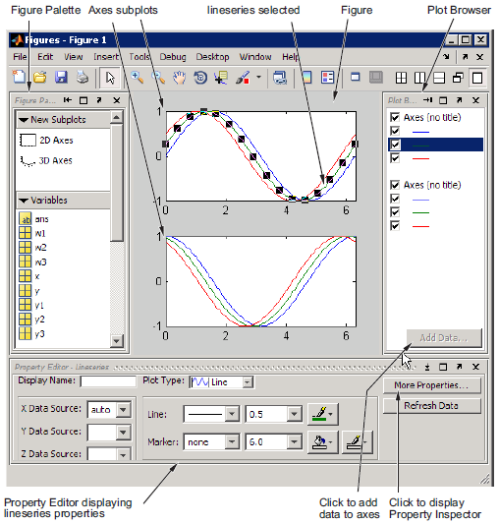
Activating Plotting Tools
Notes:
Managing Plotting Tools
Each of the plotting tools shown above can be docked or undocked from its
figure, or dismissed by clicking the x at the right end of its titlebar. If you
dismiss a tool and want it back again, you can raise it from the View menu or
by typing one of several commands. For instance, if you had undocked, and
then dismissed the figure palette, you could type either
plottools( 'on', 'figurepalette')
or
figurepalette

Slide 38
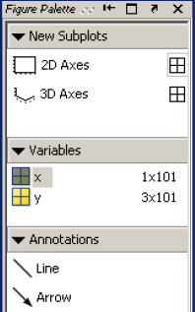
The Figure Palette
The Figure Palette contains three panels. Select the panel you want to view by clicking the respective button, which twists down the panel and exposes its contents.
The Figure Palette enables you to perform the following tasks with these panels:
New Subplots — Add 2-D or 3-D axes to the figure.
Variables — Browse and plot workspace variables.
Annotations — Add annotations to graphs.

Slide 39
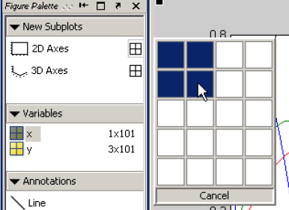
The Figure Palette
Adding Subplot Axes
The New Subplots panel enables you to create a grid of either 2-D or 3-D axes. To display the selector, click the grid icon next to the axes type. A subplot selector grid appears.
As you move the cursor, squares darken to indicate the layout of axes that will be created if you release the mouse button. Click Cancel at the bottom of the grid to leave the figure unchanged

Slide 40
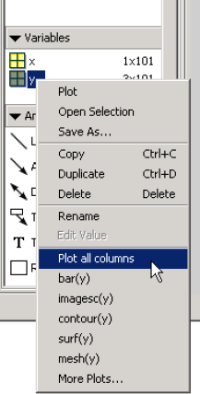
The Figure Palette
Plotting Workspace Variables
The Variables panel displays current workspace variables. Double-clicking a variable in this panel opens that variable in the Variable Editor. If you select a variable and right-click to display the context menu, you can select a graphics function to plot the variable.

Slide 41
The Figure Palette
Drag and Drop Plotting
You can also drag the variable directly into an axes, in which case MATLAB selects the first appropriate plot type for that variable. If there are multiple axes, you must first select the one you want to plot in and then drag the
variable to that axes.
Note If the desired plotting function is not available from the context menu, you can select More Plots to display the Plot Catalog tool.

Slide 42
The Figure Palette
The Plot Catalog Tool
The Plot Catalog tool provides access to most of the MATLAB plotting functions. You can type any workspace variables or MATLAB expressions in the Plotted Variables field, which are then passed to the selected plotting function as arguments. Separate variables with a comma.
Note The Plot Catalog does not prevent you from passing inappropriate or insufficient data to a plotting function; if the plot appears to be incorrect or if a plot fails to draw after you press Plot or Plot in New Figure, you should check the Command Window for warning and error messages.

Slide 43
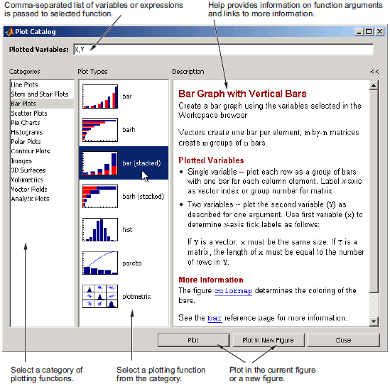
The Figure Palette

Slide 44
The Figure Palette
Adding Annotations to Graphs
The Annotations panel enables you to insert annotation objects into a plot. To add an object, first select the object you want to add, and then click and drag the mouse to position and size the object.

Slide 45
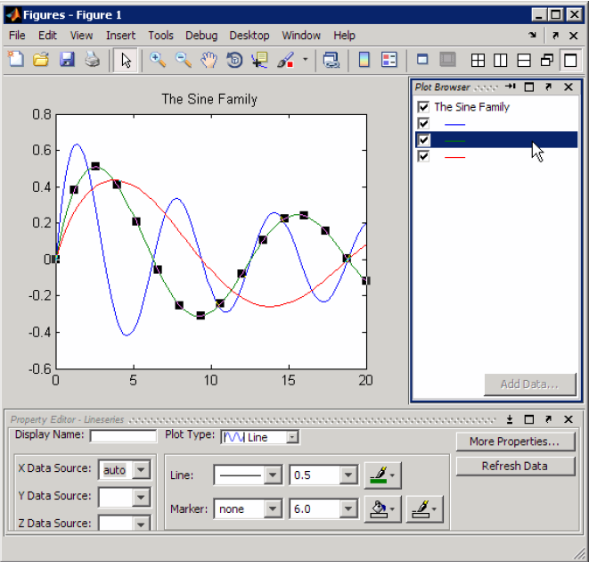
The Plot Browser
Notes:
The Plot Browser provides a legend of all the graphs in the figure. It lists each axes and the objects (lines, surfaces, etc.) used to create the graph.
For example, suppose you plot an 11-by-11 matrix z. The plot function creates one line for each column in z.
plot(z,'DisplayName','z')
When you set the DisplayName property, the Plot Browser indicates which line corresponds to which column.
If you want to set the properties of an individual line, double-click on the line in the Plot Browser. Its properties are displayed in the Property Editor, which opens on the bottom of the figure.
You can select a line in the graph, and the corresponding entry in the Plot Browser is highlighted, enabling you to see which column in the variable produced the line.

Slide 46
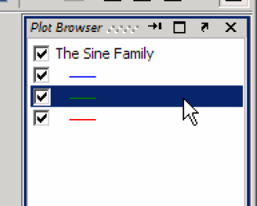
The Plot Browser
Controlling Object Visibility and Delete Objects
The check box next to each item in the Plot Browser controls the object’s visibility.
You can delete any selected item in the Plot Browser by selecting Delete from the right-click context menu.

Slide 47
The Plot Browser
Adding Data to Axes
The Plot Browser provides the mechanism by which you add data to axes. The procedure is as follows:
Select a 2-D or 3-D axes from the New Subplots subpanel.
After creating the axes, select it in the Plot Browser panel to enable the Add Data button at the bottom of the panel.
Click the Add Data button to display the Add Data to Axes dialog.
Note The Add Data to Axes dialog enables you to select a plot type and specify the workspace variables to pass to the plotting function. You can also specify a MATLAB expression, which is evaluated to produce the data to plot.

Slide 48
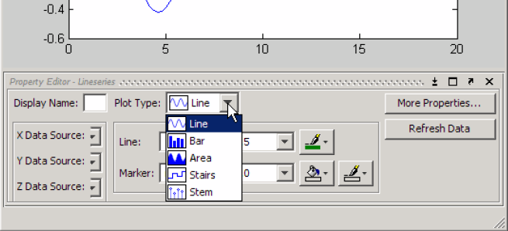
The Property Editor
Notes:
The Property Editor enables you to access a subset of the selected object’s properties. When no object is selected, the Property Editor displays the figure’s properties.

Slide 49
The Property Editor
Ways to Display the Property Editor
There are variety of ways to display the Property Editor.
Double-click an object when plot edit mode is enabled.
Select an object and right-click to display its context menu, then select Properties.
Select Property Editor from the View menu.
Use the propertyeditor command.
Notes:
The Property Editor enables you to access a subset of the selected object’s properties. When no object is selected, the Property Editor displays the figure’s properties.
Add some examples to express this applications.(1-56)

Slide 50
Editing Plots

Slide 51
Why Edit Plots?
Interactive Plot Editing
Using Functions to Edit Graphs

Slide 52
Why Edit Plots?
MATLAB® graphs are formatted to provide readability, setting the scale of axes, including tick marks on the axes, and using color and line style to distinguish the plots in the graph. However, if you are creating presentation graphics, you might want to change this default formatting or add descriptive labels, titles, legends, and other annotations to help explain your data.
You can edit the plots you create two ways:
Using the mouse to select and edit objects interactively
Using MATLAB functions at the command line or in an M-file

Slide 53
Interactive Plot Editing
If you enable plot editing mode in the MATLAB figure window, you can perform point-and-click editing of your graph. In this mode, you can modify the appearance of a graphics object by double-clicking on the object and changing the values of its properties. You access the properties through a graphical user interface called the Property Editor.

Slide 54
Using Functions to Edit Graphs
If you prefer to work from the MATLAB command line or if you are creating an M-file, you can use MATLAB commands to edit the graphs you create. Taking advantage of the MATLAB Handle Graphics® system, you can use the set and get commands to change the properties of the objects in a graph.
Note Plot editing mode provides an alternative way to access the properties of MATLAB graphic objects. However, you can only access a subset of object properties through this mechanism. You might need to use a combination of interactive editing and command-line editing to achieve the effect you desire.

Slide 55
Saving Your Work

Slide 56
Saving a Graph in MAT-File Format
Saving to a Different Format — Exporting Figures
Printing Figures
Generating an M-File to Recreate a Graph

Slide 57
Saving a Graph in MAT-File Format
The MATLAB FIG-file is a binary format to which you can save figures so that they can be opened in subsequent MATLAB sessions. These files have a .fig filename extension.
To save a graph in a figure file
Select Save from the figure window File menu or click the Save button on the toolbar. If this is the first time you are saving the file, the Save As dialog box appears.
Make sure that the Save as type is MATLAB Figure (*.fig).
Specify the name you want assigned to the figure file.
Click OK.

Slide 58
Opening a Figure File
To open a figure file, perform these steps:
Select Open from the File menu or click the Open button on the toolbar.
Select the figure file you want to open and click OK.

Slide 59
Saving to a Different Format — Exporting Figures
To save a figure in a format that can be used by another application, such as the standard graphics file formats TIFF or EPS, perform these steps:
Select Export Setup from the File menu.
Select Export from the Export Setup dialog.
Select the format from the list of formats in the Save as type drop-down menu.
Enter the name you want to give the file, less the extension.
Click Save.

Slide 60
Basic Plotting Commands

Slide 61
Setting Up Figures
Using High-Level Plotting Functions
Line Plots of Matrix Data
Plotting Imaginary and Complex Data

Slide 62
Setting Up Figures
Function | Description
figure figure(h) | creates a new window and makes it the current figure
subplot(m,n,i) | breaks the figure window into an m-by-n matrix of small subplots and selects the ith subplot for the current plot
colordef | Set color defaults

Slide 63
Using High-Level Plotting Functions
Functions for Plotting Line Graphs
Function | Description
plot | Graph 2-D data with linear scales for both axes
plot3 | Graph 3-D data with linear scales for both axes
loglog | Graph with logarithmic scales for both axes
semilogx | Graph with a logarithmic scale for the x-axis and a linear scale for the y-axis
semilogy | Graph with a logarithmic scale for the y-axis and a linear scale for the x-axis
plotyy | Graph with y-tick labels on the left and right side

Slide 64
Line Plots of Matrix Data
When you call the plot function with a single matrix argument
plot(Y)
One line is plotted for each column of the matrix. The x-axis is labeled with the row index vector 1:m, where m is the number of rows in Y.
Notes:
Example
Z = peaks; % return a 49 * 49 matrix obtained by evaluating a function of two variables.
Plot(Z); % plotting this matrix product a graph of 49 lines

Slide 65
Plotting Imaginary and Complex Data
When the arguments to plot are complex (i.e., the imaginary part is nonzero), All MATLAB® graphics functions ignore the imaginary part except when plot is given a single complex data argument. For this special case, the command produces a plot of the real part versus the imaginary part.
plot(Z)
is equivalent to
plot(real(Z), imag(Z))

Slide 66
Printing and Exporting

Slide 67
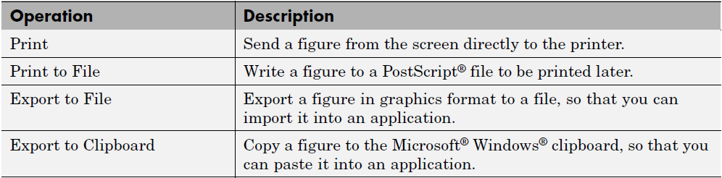
Print and Export Operations

Slide 68
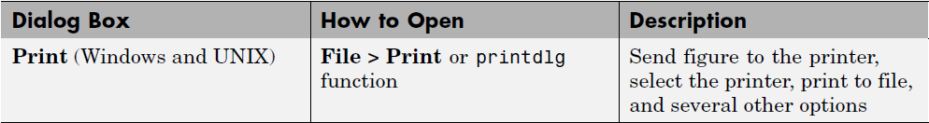
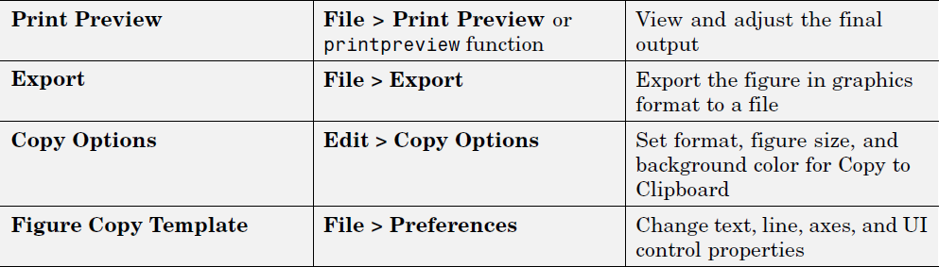
Graphical User Interfaces

Slide 69
Example — Dollying the Camera
In the camera metaphor, a dolly is a stage that enables movement of the camera from side to side with respect to the scene. The camdolly command implements similar behavior by moving both the position of the camera and the position of the camera target in unison (or just the camera position if you so desire).

Slide 70
Example — Dollying the Camera
Summary of Techniques
This example illustrates how to use camdolly to explore different regions of an image. It shows how to use the following functions:
ginput to obtain the coordinates of locations on the image
The camdolly data coordinates option to move the camera and target to the new position based on coordinates obtained from ginput
camva to zoom in and to fix the camera view angle, which is otherwise under automatic control

Slide 71
Example — Dollying the Camera
Implementation
First load the Cape Cod image and zoom in by setting the camera view angle (using camva).
load cape
image(X)
colormap(map)
axis image
camva(camva/2.5)

Slide 72
Example — Dollying the Camera
Implementation
Then use ginput to select the x- and y-coordinates of the camera target and camera position.
while 1
[x,y] = ginput(1);
if ~strcmp(get(gcf,'SelectionType'),'normal')
break
end
ct = camtarget;
dx = x - ct(1);
dy = y - ct(2);
camdolly(dx,dy,ct(3),'movetarget','data')
drawnow
end

Slide 73
Example — Moving the Camera Through a Scene
Summary of Techniques
A fly-through is an effect created by moving the camera through three-dimensional space, giving the impression that you are flying along with the camera as if in an aircraft. You can fly through regions of a scene that might be otherwise obscured by objects in the scene or you can fly by a scene by keeping the camera focused on a particular point.
To accomplish these effects you move the camera along a particular path, the x-axis for example, in a series of steps. To produce a fly-through, move both the camera position and the camera target at the same time.

Slide 74
Example — Moving the Camera Through a Scene
The following example makes use of the fly-though effect to view the interior of an isosurface drawn within a volume defined by a vector field of wind velocities. This data represents air currents over North America.
This example employs a number of visualization techniques. It uses
Isosurfaces and cone plots to illustrate the flow through the volume
Lighting to illuminate the isosurface and cones in the volume
Stream lines to define a path for the camera through the volume
Coordinated motion of the camera position, camera target, and light

Slide 75
Example — Moving the Camera Through a Scene
Graphing the Volume Data
The first step is to draw the isosurface and plot the air flow using cone plots.
Setting the data aspect ratio (daspect) to [1,1,1] before drawing the cone plot enables MATLAB® software to calculate the size of the cones correctly for the final view.

Slide 76
Example — Moving the Camera Through a Scene
load wind
wind_speed = sqrt(u.^2 + v.^2 + w.^2);
hpatch = patch(isosurface(x,y,z,wind_speed,35));
isonormals(x,y,z,wind_speed,hpatch)
set(hpatch,'FaceColor','red','EdgeColor','none');
[f vt] = reducepatch(isosurface(x,y,z,wind_speed,45),0.05);
daspect([1,1,1]);
hcone = coneplot(x,y,z,u,v,w,vt(:,1),vt(:,2),vt(:,3),2);
set(hcone,'FaceColor','blue','EdgeColor','none');

